Slide 1
Prolonged Neonatal Jaundice
Ahmed Laving

Slide 2
Prolonged Jaundice?
>6 months
>3 months
>2 weeks
>4 weeks

Slide 3
Prolonged Jaundice?
>6 months
>3 months
>2 weeks
>4 weeks

Slide 4
Case Presentation
6 week old born in UK via c/section to a primi-gravida
Jaundice from week 2 of life; reassured by midwife visits at home
Returned to Kenya and brought for well baby visit/vaccination at 6 weeks
Noted to have jaundice; otherwise well
Stool colour reported as normal by mother
What’s your next step?

Slide 5
Case Presentation (2)
Stool colour: pale
Differential diagnosis?
Investigations?
Treatment: ?expose to sunlight

Slide 6
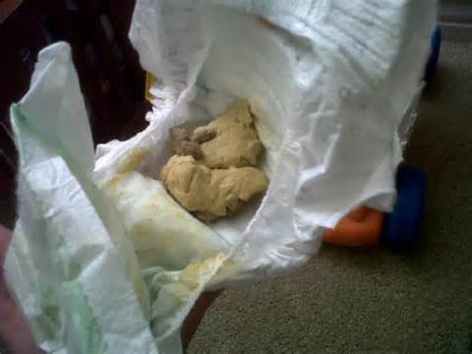

Slide 7
Prolonged Neonatal Jaundice
Jaundice persisting for >2 weeks in a term infant, and >3 weeks in a preterm infant
Needs urgent evaluation
About 2.4-9% of exclusively breast-fed babies may have jaundice beyond 2 weeks of age (unconjugated)
Winfield CR. Clinical study of jaundice in breast and bottle fed babies. Arch Dis Child 1978

Slide 8
Neonatal Cholestasis
Defined as conjugated hyperbilirubinaemia developing within 60 days of birth
Conjugated bilirubin >20% of total bilirubin
Cholestatic jaundice affects 1 in 2500 infants
Guidelines recommend evaluation of every neonate with jaundice > 2 weeks of age
Naspghan Guidelines JPGHN 2004

Slide 9
Aetiology
Basic distinction is between:
Extra-hepatic aetiologies
Intra-hepatic aetiologies

Slide 10
Extra-hepatic Causes
Extra-hepatic biliary atresia
Choledochal cyst
Inspissated bile/mucus plug
Cholelithiasis
Cystic fibrosis
Congenital hepatic fibrosis

Slide 11
Intra-hepatic Causes
Infectious
Idiopathic neonatal hepatitis syndrome
TORCHES
Hepatitis B,C
Sepsis
E.coli UTI
Endocrine
hypothyroidism
Metabolic
Galactosaemia
Tyrosinaemia
Alpha1antitrypsin def.
Haemachromatosis
Congenital
Alagille’s syndrome
Toxic
TPN associated
Idiopathic

Slide 12
Clinical Presentation
Jaundice >2 weeks
Acholic stools
Dark urine
+/- Lethargy, irritability
Bleeding tendency
Scleral icterus
+/- Pallor
Hepatomegaly
?dysmorphic features
+/- failure to thrive

Slide 13
Stool colour
Parents not reliable observers of stool colour
Clinicians better at detecting acholic stool
Stool colour card improves early case finding
Crofts DJ. Assessment of stool colour in community management of prolonged jaundice in infancy. Acta Paediatr 1999;88

Slide 14
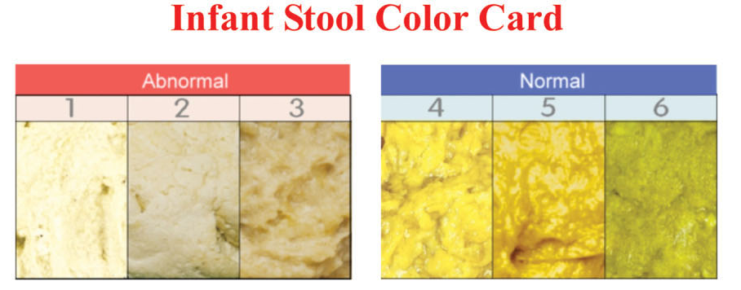

Slide 15
Goals of Timely Evaluation
Diagnose and treat known medical and/or life-threatening conditions
Hypothyroidism
Galactosaemia
UTI
Sepsis
Identify disorders amenable to surgical therapy within an appropriate time-frame
Choledochal cyst
Biliary atresia

Slide 16
Initial Evaluation of Jaundiced Infant

Slide 17
Initial Evaluation of Jaundiced Infant
Is the infant ill looking?
Sepsis
Galactosaemia
Haemolysis
If infant stable:
Bilirubin: total/direct
If cholestatic, urgent!
LFT’s, PTI, Albumin, RBS
FBC, Urine mcs, TSH
Abdominal US
Liver biopsy
Others
ADMIT

Slide 18
Jaundiced infant
2-8 wks of age
History:
Pale stool, dark urine
Exclusive breastfeeding
Is the pt acutely ill?
Requires urgent care?
Yes
No
Manage acute illness
Consider sepsis, UTI, haemolysis,
Galactosemia, acute duct obstruction
Measure serum total +
direct bilirubin
Is direct bilirubin
>20% of total bilirubin?
Yes
No
Indirect
Hyperbilirubinemia
Cholestasis

Slide 19
CHOLESTASIS
INDIRECT HYPERBILIRUBIN
Consider biliary atresia, choledochal cyst,
galactosaemia, hypothyroidism, UTI
Consider breast milk jaundice, UTI,
ABO incompatibility, hypothyroidism
Investigations:
FBC, LFT, PTI, Albumin, Glucose
Urine reducing substances + m/c/s
Thyroid profile, ferritin levels
Abdominal Ultrasound, TORCH
Liver biopsy, Others
Investigations:
FBC, LFT, PTI, Albumin, Glucose
PBF + Blood Group + Coomb’s test
Septic screen, Urine m/c/s
Thyroid profile, Others
Consult appropriately:
Paediatric GI
Paediatric Surgeon
Paediatric Metabolic Expert
Consult appropriately

Slide 20
Abdominal Ultrasound
Fasting (3-4 hours)
If gall bladder contracted/not visualized, suggestive of Biliary Atresia (73-100% sensitivity, 67-100% specificity)
“Triangular cord” sign: fibrous cone of tissue at bifurcation of portal vein (83-100% sensitivity, 98-100% specificity to detect biliary atresia)
Detects choledochal cysts
Naspghan Guidelines JPGHN 2004

Slide 21
Radionucleide scan
Hepatobiliary scintigraphy
Premedicate with phenobarbital 5mg/kg/d
Demonstrate uptake into and excretion from the liver
Costly
MRCP

Slide 22
Liver biopsy
High sensitivity (96%) and sensitivity (92%) for Biliary Atresia
Also helpful in diagnosing neonatal hepatitis syndrome, and other metabolic conditions
Dehgani SM. Comparison of different diagnostic methods in infants with cholestasis. World J Gastroenterol 2006

Slide 23
Treatment
Medical management
Nutritional support
Treatment of pruritus
Choleretics and bile acid-binders
Management of portal hypertension and its consequences
Specific treatment depends on aetiology

Slide 24
Nutritional Treatment
Adequate calories and protein
Supplement calories with medium chain triglycerides
Maintain levels of essential long-chain fatty acids
Treatment and/or prophylaxis for fat-soluble vitamin deficiencies

Slide 25
Biliary Atresia
Progressive inflammation of bile ducts, causing biliary tract fibrosis, obstruction and eventually liver cirrhosis
Incidence: 1 in 8,000; most common cause of chronic cholestasis in infants
Aetiology: unknown
Well looking, jaundiced infant
Early diagnosis and treatment before 60 days improves outcome
Balistreri WF. Liver disease in children 2007

Slide 26
BA: Kasai Procedure
Roux-en-Y portoenterostomy to re-establish bile flow
Bile flow re-established in 80-85% if performed prior to 8 weeks-old
Bile flow re-established in less than 20% if performed after 12 weeks-old
Liver transplant for late diagnosis and “failed” Kasai
Chardot C. J Pediatr 2001, McClement JW. Br Med J. 1985

Slide 27
Choledochal Cyst
Congenital cystic dilatation of biliary tract (extra- or intra-hepatic)
Incidence: 1:15,000, up to 2% of infants with prolonged jaundice
Obstruction of bile flow, eventually leading to biliary cirrhosis
Rx: complete excision of cyst mucosa with Roux-en-Y choledochojejunostomy
Risk of carcinoma in residual cystic tissue in 26%
Stringer MD. Arch Dis Child 1995

Slide 28
Hypothyroidism
Thyroid hormones involved in regulation of bile composition and flow
20% of neonates with hypothyroidism present with prolonged jaundice
2/3 with unconjugated hyperbilirubinaemia
1/3 with cholestasis
TSH screening as part of prolonged jaundice work-up
MacGillivray MH. Pediatr. 1997

Slide 29
UTI
UTI found in 7.5% of asymptomatic, afebrile, jaundiced infants younger than 8 weeks old
Patients with elevated conjugated bilirubin more likely to have a UTI
Recommend testing for UTI included as part of evaluation of asymptomatic, jaundiced infants
Garcia FJ. Pediatr 2003

Slide 30
Summary
Cholestatic jaundice should be excluded in all infants with prolonged jaundice >14 days
Infantile cholestasis needs early recognition and diagnostic evaluation:
Early treatment of medical conditions
short window period for surgical treatment
No role of “sunlight phototherapy” beyond 2 weeks of age

Slide 31
Thank You!

Slide 32
Homework
Biliary atresia
Hypothyroidism
Galactosemia

Slide 34
